Slide 1


Expense Reimbursement System
This project builds an enterprise-grade expense management system with AI-powered bill validation, enabling automated processing and multi-level approval workflows to streamline reimbursements and reduce processing time.
Project Team: Gagan Raam S, Preethi T K, Aksa B Chacko

Slide 2
Objective
1
Objective
2
Goal
3
Key Challenge
Build an enterprise expense management system with AI-powered bill validation to automate expense processing and multi-level approval workflows.
Streamline corporate reimbursements by reducing manual processing time by 70% and eliminating fraud through intelligent automation.
Automating bill authenticity verification and data extraction while maintaining security, audit compliance, and multi-role approval workflows.

Slide 3
What Sets Us Apart
1
AI-Powered Bill Validation
4
Advanced Search & Analytics
Unlike traditional systems that rely on manual verification, this system uses Google Gemini AI to automatically detect fraudulent bills, verify authenticity, and extract data with 95%+ accuracy in 2-5 seconds.
Elasticsearch-powered search across millions of expenses with instant results. Filter by category, status, date, amount—far beyond basic SQL queries.
2
Zero Manual Data Entry
5
Zero Manual Data Entry
Employees simply upload bills and select a category. AI handles the rest—extracting dates, amounts, vendor names, and GST numbers automatically, reducing form fields by 90% and errors to near zero.
Every action tracked with user, timestamp, IP, and state changes. JWT authentication, role-based access, and bcrypt hashing ensure enterprise security.
3
Intelligent Multi-Level Approval
Automated routing through Manager → Finance with grade-based limits (₹10K-₹50K). Auto-rejects policy violations before reaching approvers.

Slide 4
Importance of
Automated Expense Management
Time Efficiency
Cost Reduction
Compliance & Transparency
1
2
3
Reduces processing time by 70%, enabling teams to handle hundreds of expenses in hours instead of days.
Eliminates fraud through AI validation, reduces overhead costs, and minimizes reimbursement errors.
Ensures policy compliance with automated checks, maintains complete audit trails, and provides real-time expense visibility.
4
Employee Satisfaction
Faster reimbursements and paperless process improve employee experience and build trust through transparency.

Slide 5
Expense Management Use Cases
Corporate Travel
Client Entertainment
Medical & Training
Employees submit flight, hotel, and cab receipts. AI extracts vendor, amount, and GST automatically for quick approval and reimbursement.
Sales teams upload restaurant bills. Manager approves based on context, HR verifies policy compliance, Finance processes payment.
Employees claim medical or training expenses. System validates bills, checks grade limits, and routes through multi-level approval.

Slide 6
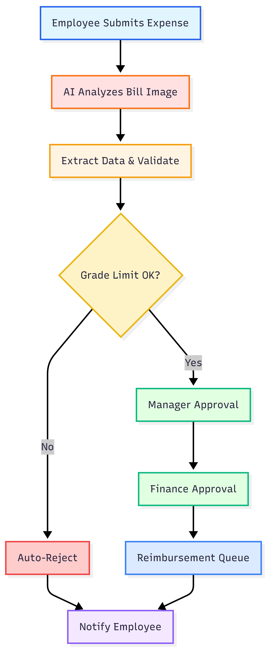
Project Workflow
1
Expense Submission
Employee uploads bill and enters basic details. System validates file format and size.
2
AI Bill Analysis
Google Gemini AI analyzes bill, verifies authenticity, and extracts all data automatically.
3
Validation & Storage
System checks grade limit, saves to database, stores file securely, and indexes for search.
4
Approval Routing
Routes through Manager → Finance. Notifications sent at each approval stage.
5
Final Processing
After final approval, expense queued for reimbursement and employee notified.

Slide 7
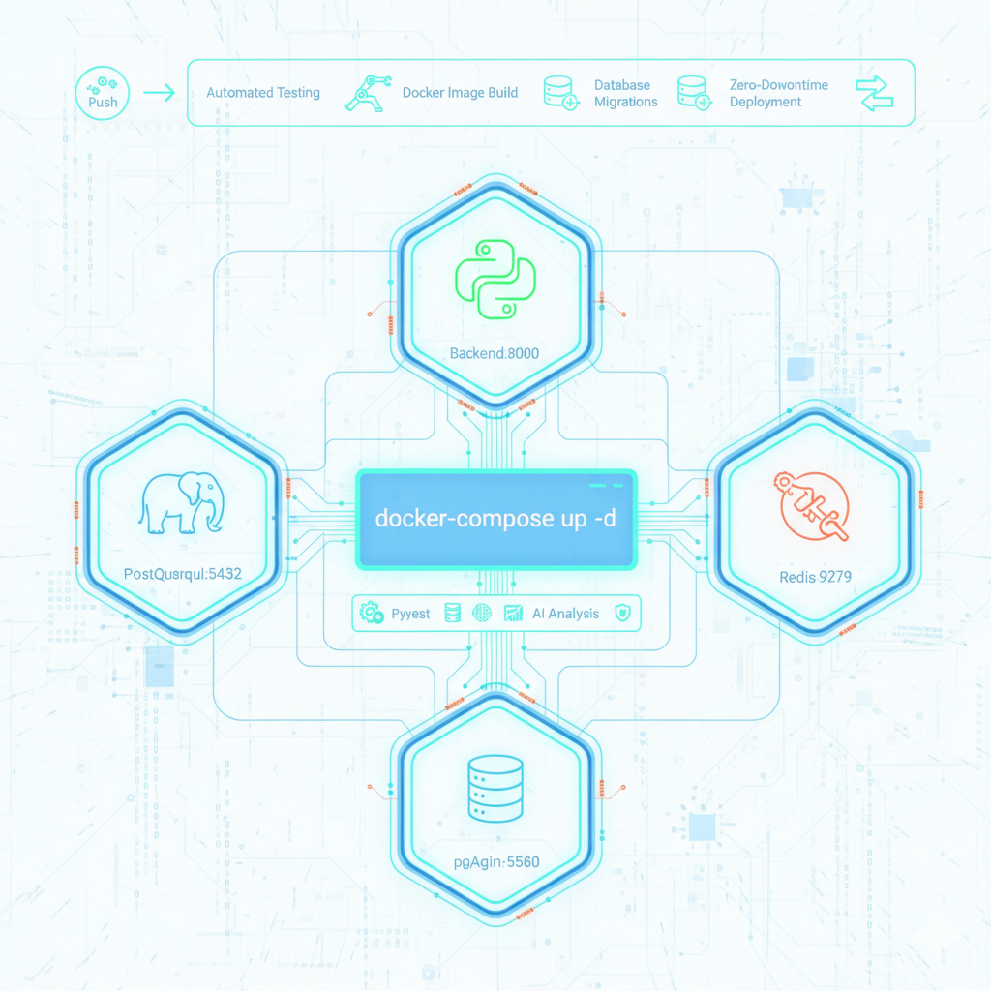
Deployment and Testing
Deployment
Docker Compose deployment with 5 services (Backend:8000, PostgreSQL:5432, Redis:6379, Elasticsearch:9200, pgAdmin:5050). Single command: docker-compose up -d
Testing
Pytest for unit/integration tests, API endpoint validation, AI analysis accuracy testing, and authentication/authorization flow verification.
Automation
GitHub Actions CI/CD pipeline with automated testing on push, Docker image building, database migrations, and zero-downtime deployment.

Slide 8





Tools and Technologies
FastAPI
High-performance Python web framework for building REST APIs with automatic OpenAPI documentation.
PostgresSQL
Robust relational database for storing expenses, users, approvals, and audit logs with ACID compliance.
Docker
Containerization platform for packaging application with all dependencies for consistent deployment.
Elasticsearch
Distributed search engine for full-text search, advanced filtering, and real-time expense indexing.
Google Gemini AI
Advanced AI model for bill image analysis, authenticity verification, and automatic data extraction.

Slide 9




Project Status (Complete)
Backend API Development
Complete
Database & Search Setup
Complete
AI Bill Analysis Integration
Complete
Multi-Level Approval System
Complete
Docker Deployment
Complete

Slide 10

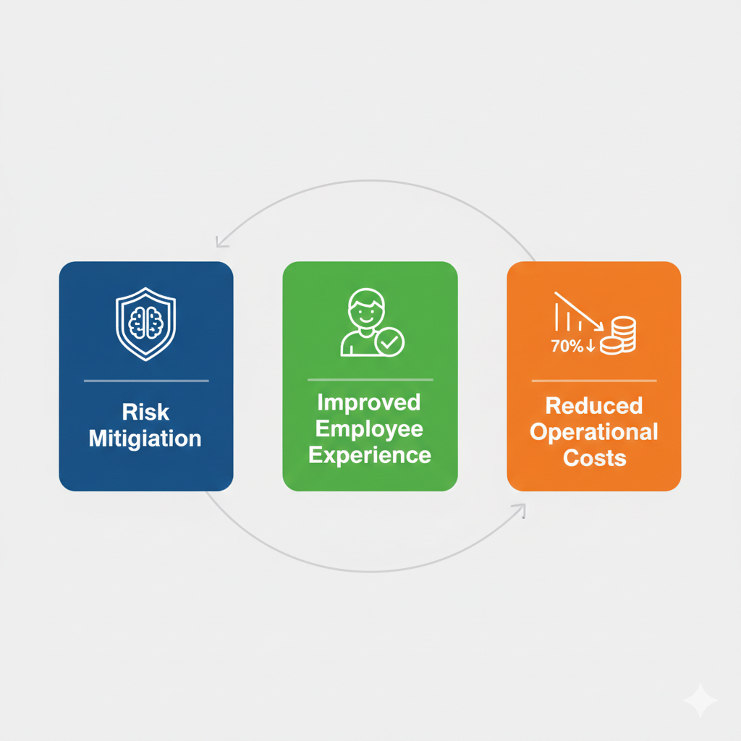
Expected Outcome
1
Cost Reduction
2
Employee Satisfaction
3
Ensure Compliance & Control
Reduce operational costs by 70% through automated processing, fraud elimination, and minimized manual oversight requirements.
Improve employee experience with faster reimbursements, paperless processes, and transparent tracking of expense status.
Maintain complete audit trails, enforce policy compliance automatically, and prevent fraud with AI-powered bill validation for risk mitigation.

Slide 11
My Contribution
AI Bill Analysis Integration
Google Gemini AI integration for automated validation and data extraction
Approval Workflow Engine
Multi-level approval system with automated routing and notifications.
Search & Analytics
Elasticsearch-powered search with advanced filtering and real-time indexing.
Security & Deployment
JWT authentication, RBAC, audit logging, and containerized deployment.

Slide 12
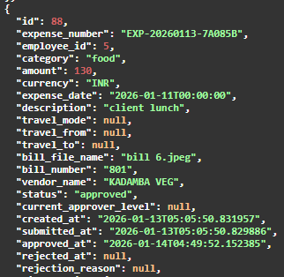
Expense Management API Endpoints
Creates single expense claim with bill upload and triggers Google Gemini AI for automatic validation and data extraction.
Creates expense with multiple bill attachments, each analyzed separately by AI for comprehensive validation.
Response after the bill being submitted for reimbursement:

Slide 13
Retrieves all expenses for the current user with filters for status, category, date range, and pagination support.
Checks AI analysis processing status (PENDING, PROCESSING, COMPLETED, FAILED) for real-time progress tracking.
Updates draft expense details and re-triggers AI analysis if bill file is changed (only for DRAFT status).
Permanently deletes draft expense and removes associated bill files from storage (only for DRAFT status).

Slide 14
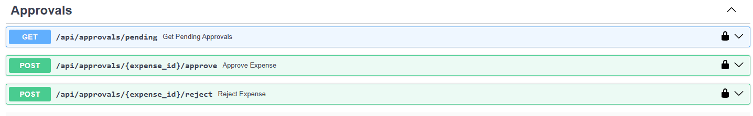
APPROVAL ENDPOINTS
Returns expenses awaiting approval filtered by current user's role (Manager sees team expenses, Finance sees all).
Approves expense, routes to next approval level (Manager → Finance), and sends notifications to all stakeholders.
Rejects expense with mandatory reason, sets status to REJECTED, and immediately notifies the employee.

Slide 15
NOTIFICATION ENDPOINTS
Retrieves all notifications for current user with optional filter for unread-only notifications.
Marks single notification as read and updates the unread count for the user.
Permanently deletes a single notification from the user's notification list.

Slide 16
REPORTS & ANALYTICS ENDPOINTS
Elasticsearch-powered advanced search with full-text query, category, status, date range, and amount filters.
Displays bill file in browser with proper content-type headers (PDF viewer or image display).
Downloads bill file with original filename as an attachment for offline viewing.

Slide 17
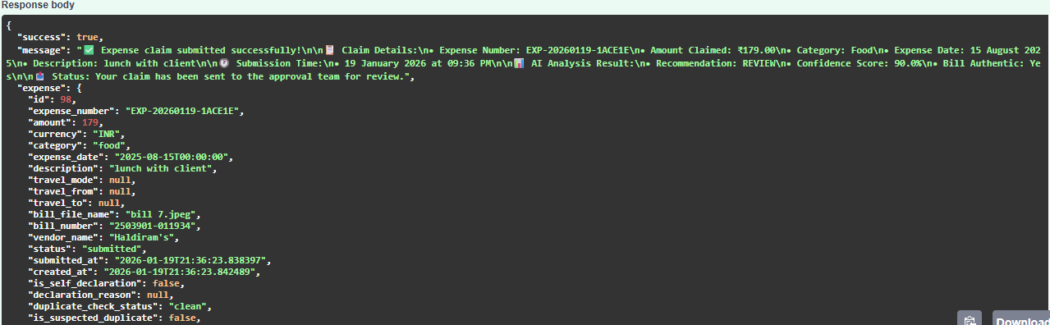
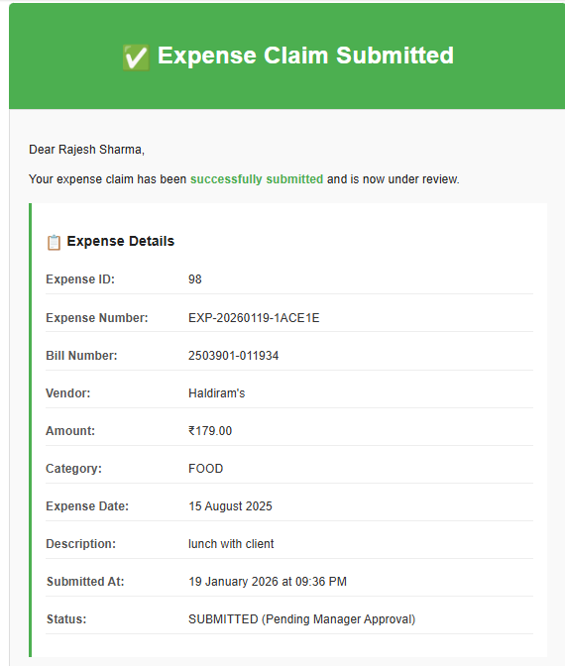
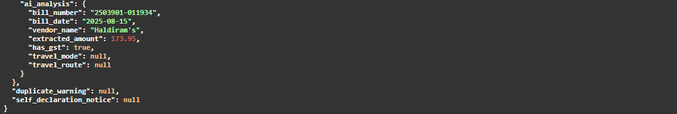
Expense Claim Submission - Complete API Response & Email Notification Flow

Slide 18
AI Analysis Results - Intelligent Recommendations for Manager Decision
"ai_analysis": {
"is_authentic": true,
"confidence_score": 90,
"bill_number": "2503901-011934",
"bill_date": "2025-08-15",
"vendor_name": "Haldiram's",
"extracted_amount": 173.95,
"has_gst": true,
"gst_number": "29AARCC08897J1ZK",
"payment_method": "UPI",
"red_flags": [
"Claimed amount (₹179.0) is higher than the actual bill amount (₹173.95)." ],
"missing_elements": [],
"recommendation": "REVIEW",
"recommendation_reason": "The bill is authentic and falls within the employee's grade limits for food expenses. However, there is a discrepancy between the claimed amount of ₹179.0 and the actual total on the bill, which is ₹173.95. The claim should be adjusted to match the accurate bill amount of ₹173.95.",
"summary": "Authentic Haldiram's bill for ₹173.95 is within limits, but the claimed amount of ₹179.0 is higher than the bill total.",
"detailed_analysis": "The bill from Haldiram's (Dak Industries India Private) is dated 2025-08-15 (DD/MM/YYYY parsed as YYYY-MM-DD 2025-08-15). This date is in the past relative to today's date (2026-01-19). The vendor name 'Haldiram's' is clearly visible. The total payable amount extracted from the bill is ₹173.95, paid via UPI. The bill includes a GSTIN (29AARCC08897J1ZK) and GST bifurcation details, indicating it's a tax invoice. The extracted amount of ₹173.95 is well within the Grade A employee limits (max_amount: ₹500, max_per_day: ₹500). However, the employee has claimed ₹179.0, which is ₹5.05 higher than the actual bill total of ₹173.95. This discrepancy is a red flag and requires review to adjust the claim to the correct amount.",
"is_within_limits": [
true,
null],
"is_valid_bill": true,
"is_within_limits": true,
"validation_errors": [
"Claimed amount (₹179.0) is higher than the actual bill amount (₹173.95)."
],
"has_gst": true,
"has_required_stamps": null,
"file_hash": "f1aeff47c237f4c212e2f2cac7dd50cbf97e887e93cd701a689018a6ebf3d58f",
"duplicate_check_status": "clean",
"duplicate_of_expense_id": null,
"duplicate_detected_at": null,
"rejection_reason": null,
"rejected_by": null,
"paid_at": null
},

Slide 19
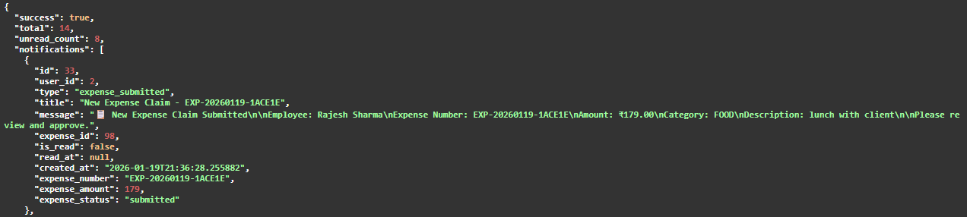
Real-Time Notification to Manager - New Expense Claim Submitted

Slide 20
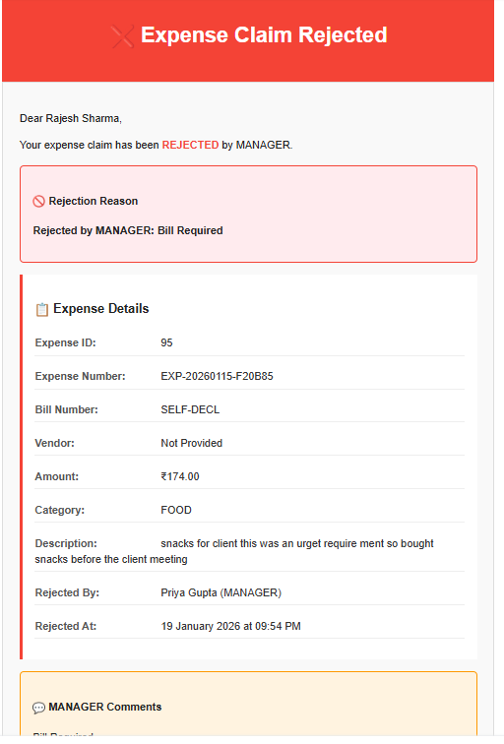
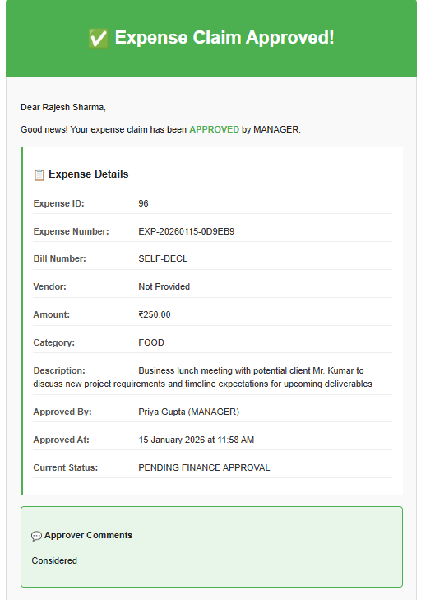
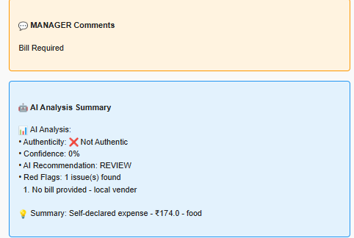
Employee Email Notifications - Approved vs Rejected Expense Claims

Slide 21
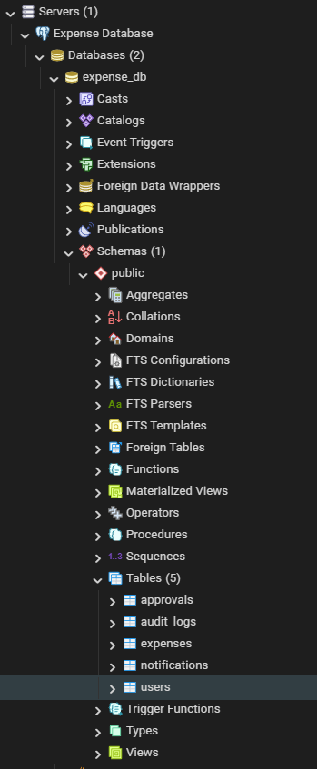
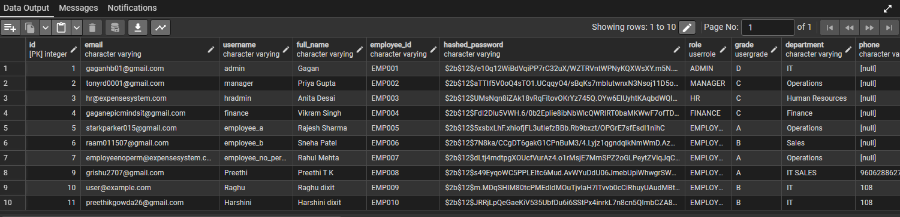
PostgreSQL Database - Users Table with Role-Based Access Control

Slide 22
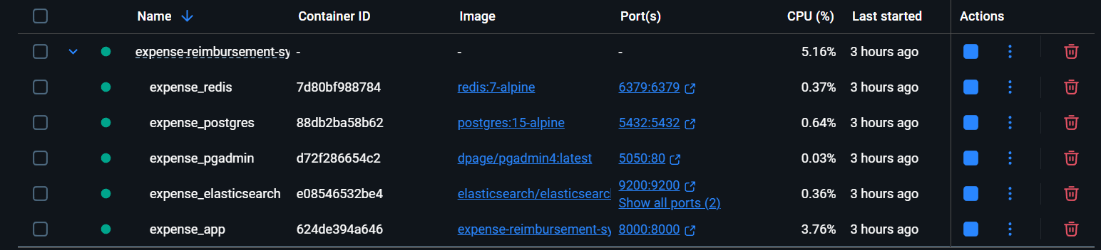
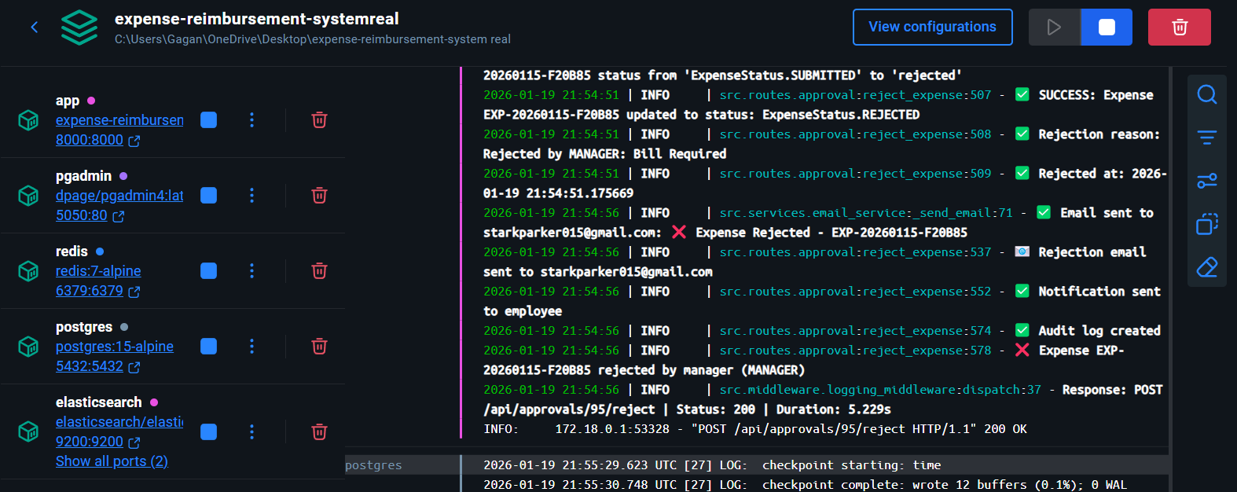
Docker Deployment - All System Services Running
Backend Application Logs - FastAPI Server Running & Processing Requests

Slide 23
Unit Testing
tests/
├── test_auth.py # Unit tests for authentication
├── test_ai_service.py # Unit tests for AI bill analysis
└── test_expense.py # Unit tests for expense management

Slide 24
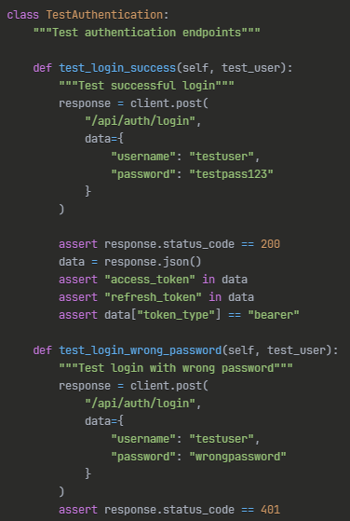
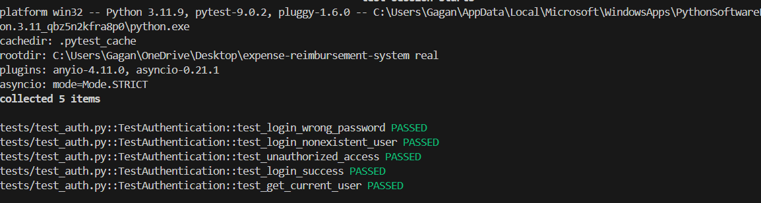
Unit Testing (Codes)
Testing (Result)
Authentication Tests (test_auth.py):

Slide 25
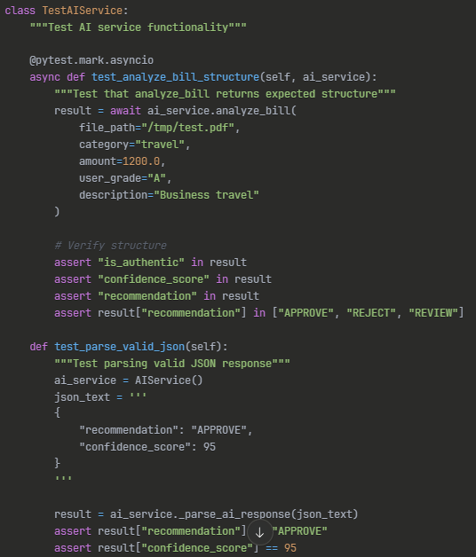
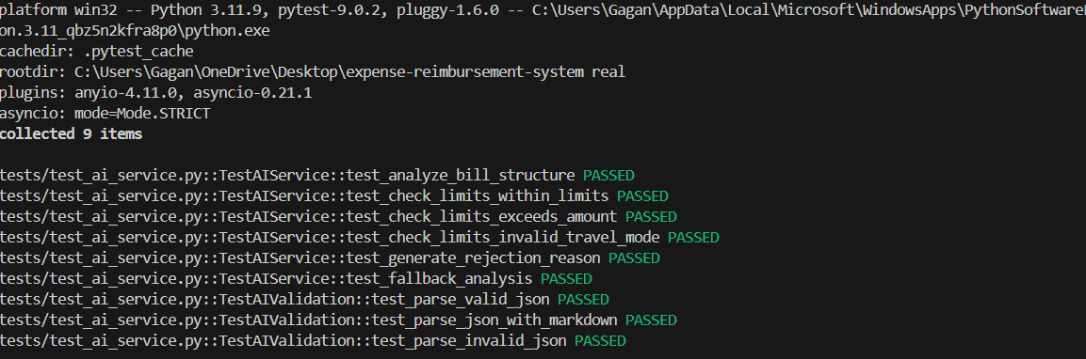
Unit Testing (Codes)
Testing (Result)
AI Service Tests (test_ai_service.py):

Slide 26
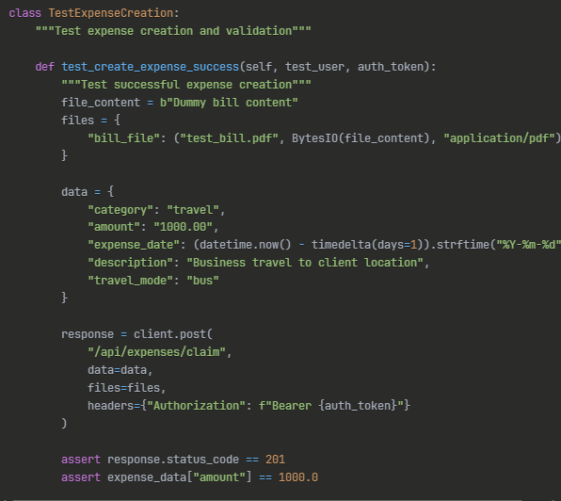
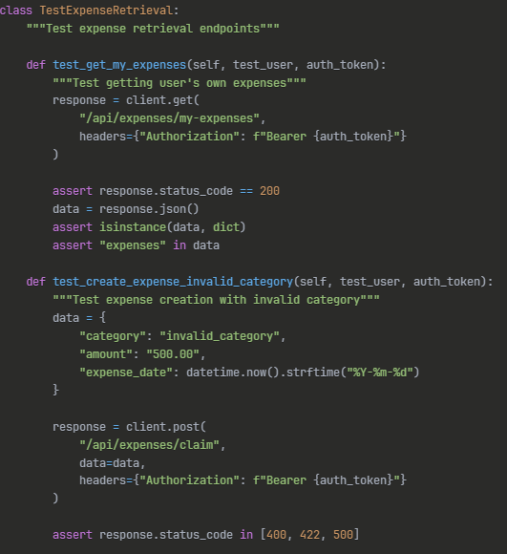
Unit Testing (Codes)
Expense Creation Tests (test_expense.py):
Expense Validation Tests (test_expense.py):

Slide 27
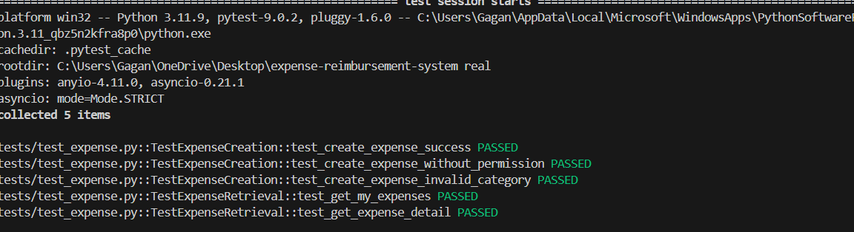
Testing (Result)

Slide 28

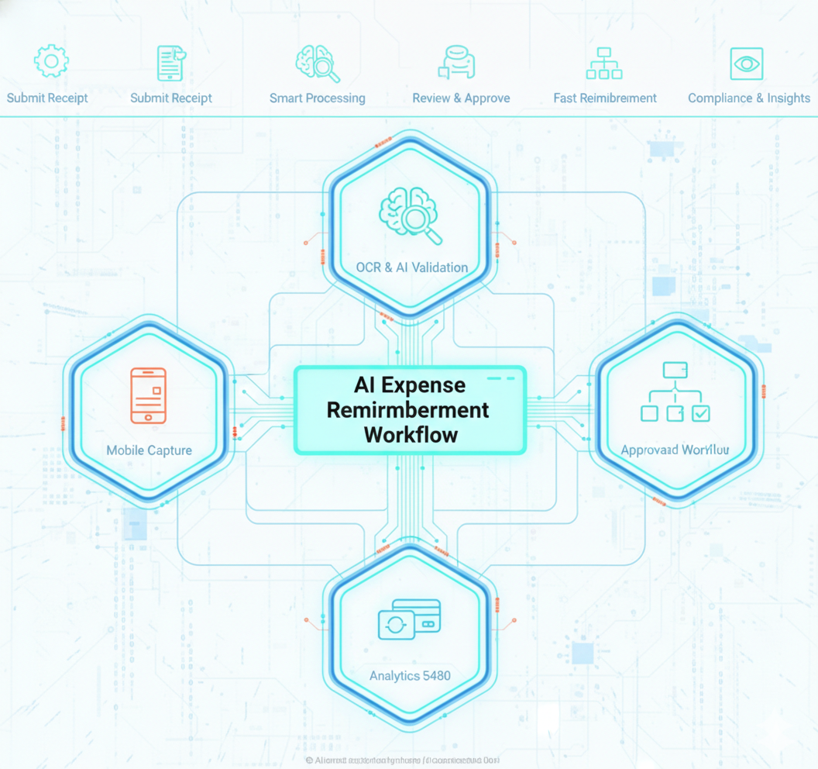
Thankyou

